Slide 1
Principles of EQA
Annette Thomas
Chair IFCC C-AQ
Director Weqas
www.weqas.com

Slide 2
What is External Quality Assessment?
proficiency testing scheme
System designed to objectively assess the quality of results by an external agency.

Slide 3
IQC vs EQA
 | Internal Quality Control | External Quality Assurance
Results | Known | Unknown
Results Available | Immediately | Later, when report received
Frequency of Testing | Minimum daily, per batch, per shift | Periodically eg monthly/ Bimonthly quarterly
Concentrations | Normal, abnormal | Pathological range covered over multiple samples
Assess | Imprecision | Accuracy & imprecision
Comparison | Your lab only | Your lab to all labs & other labs using your method

Slide 4
Types of EQA Schemes – which one for you ?
PT, EQA or EQAP?
Commercial
Not for profit
Linked to professional body
Regulatory
Scope
Broad Scope - All disciplines
Narrow Scope - Discipline specific
Limited scope – Specialist
Accredited to ISO 17043
Yes
No?

Slide 5
Expectations of EQA Provider
Accreditation status – 17043
If not accredited, labs should justify why
Clinically relevant
Distribution frequency
Evidence of reproducibility
Cover clinically appropriate range
“Blinded”
Commutable materials
Challenging samples
Variable across Schemes (EQALM study 2009) *
Where EQA used to assess IVDs, minimum of 6 distributions p.a. (BS EN 14136:2004)
For core tests - monthly
Clinically relevant
Range and number of samples
Clinically relevant performance criteria
Based on clinical outcomes
Based on biological variation
Scheme designed and overseen by appropriately competent professionals
Reporting to Professional body / Regulatory body.
Education
Post-marketing surveillance
Training
Helpline
Pre analytical
Post Analytical
Alerts manufacturers
Alerts competent authority
Alerts laboratories
Alerts professional bodies
Clinical Scientist or medically qualified
Mechanism for identification and reporting of Persistent Poor performance issues
Independent Scientific or Medical Advisory group.
Statistical expertise
* A Thomas, Accred Qual Assur (2009) 14: 439-444
* A Thomas, Accred Qual Assur (2009) 14: 439-444

Slide 6
Objectives of EQA
Provide a measure of the quality of a test
To supplement internal quality control procedures
Provide a measure of the “state of the art” of a test
To obtain consensus values when true values are unknown
To investigate factors in performance (methods, staff etc)
To act as an educational stimulus to improvement in performance
To provide a Post market vigilance service
To provide evidence and monitoring of harmonisation strategies
IFCC 1977

Slide 7
General Cycle of EQAS
User analyses EQA samples
Results sent to EQA organiser
EQA report received
EQA report reviewed
Corrective action taken if required
EQA samples received

Slide 8
Choosing an EQA - considerations
Design for clinical need
Material type & frequency
  Identify performance specification
  Data analysis
  Reports
  Education element
  Troubleshooting support

Slide 9
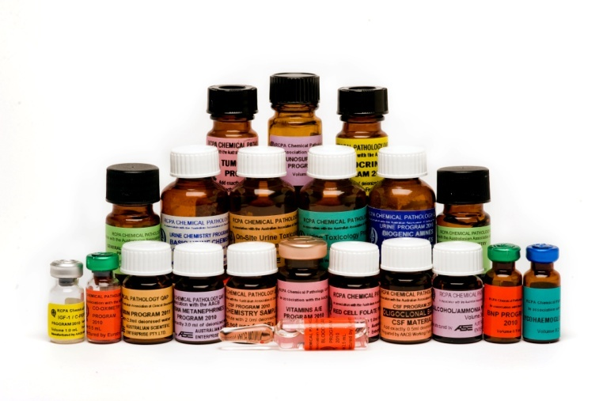
Material & Frequency
Appropriate matrix
Stable, homogeneous material
Appropriate concentration range
Challenging samples
Appropriate frequency of testing

Slide 10
Sample Matrix
Lyophilized material – serum / urine / whole blood
  Pro
  Good long term stability
  Very easy to transport
  Con
  Commutability issues
  Expensive
  Difficult to prepare - reconstitution errors
  Denaturation of proteins/lipoproteins
  Issues with assigning reference targets

Slide 11
Sample Matrix
Fresh/ Frozen clinical material - from individual donors or pool of donors
  Con
  Difficult to obtain different concentration levels
  Unstable analytes
  Storing and transport expensive
  Risk of bacterial contamination
  Pro
  Gold standard
  Commutable – performs as patient samples
  Easy to use
  Can set reference targets

Slide 12
Appropriate Concentration Levels
Clinically relevant
Range of concentration levels
Not just around the reference interval
Cover the analytical and pathological range
Challenging samples

Slide 13
Choosing an EQA?
Design for clinical need
Material type & frequency
Identify performance specification
  Data analysis
  Reports
  Education element
  Troubleshooting support

Slide 14
What is the Target Value?
Determining the ‘right’ , ‘true’, ‘correct’ value?

Slide 15
Target Value
Reference value
  “True” value with meteorological traceability.
  Commutable EQA material assayed using:
  Reference methods eg HbA1c
  By an Accredited reference laboratory
    Using higher order methods eg IDGC-MS glucose, creatinine.
    Certified Reference material

Slide 16
Advantage of Reference Measurement Targets
Traceable to higher order
Establishes method traceability for the lab– requirement of ISO 15189
Independent assessment of manufacturer traceability claims.
Highlights the pitfalls of using the trimmed overall mean as an accuracy target in EQA Schemes
Overall mean and method mean may not be traceable, may not be stable, may be influenced by large numbers from one manufacturer.
Useful in the post market vigilance of the IVD - Directive

Slide 17
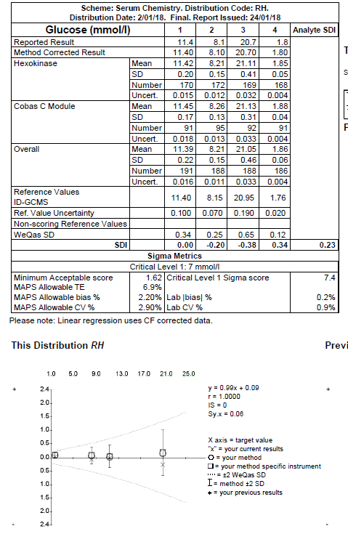
Traceability
Reference measurement values shown on report (and reference value uncertainty). Full traceability chain to SI units available.
Lab results compared directly to reference values
SDI scores, Sigma scores and bias plot based on reference values

Slide 18
Use of gravimetric data
Analyte | Gravimetric | LC-MS/MS | Recovery %
Amphetamine (ug/L) | 3000 | 2936 | 97.9
Cannabis (ug/L) | 300 | 227 | 75.7
Opiate (Morphine) (ug/L) | 5000 | 5483 | 109.7
Benzodiazepine (ug/L) | 800 | 749 | 93.6
Cocaine (ug/L) | 800 | 842 | 105.3
Methadone (EDDP) (ug/L) | 600 | 720 | 120.0
Methamphetamine (ug/L) | 3000 | 3193 | 106.4
6-Acetylmorphine (ug/L) | 30 | 25 | 83.3
Buprenorphine (ug/L) | 30 | 31 | 103.3
Ketamine (ug/L) | 3000 | 2786 | 92.9
Barbiturates (ug/L) | 800 | 820 | 102.5
MDMA (ug/L) | 2500 | 2766 | 110.6
Phencyclidine (ug/L) | 73.4 | 78* | 106.3
Traceability
Good agreement was observed between the ‘gravimetric’ weighed in target and the LC-MS/MS data for the majority of analytes, however a decreased recovery of 76% and 83% was observed for cannabis and acetylmorphine respectively.

Slide 19
Target Value
Statistical
  Overall mean, median
  Method, instrument mean
  Shows the ‘state of art’ of method performance but gives no indication of the “true” value

Slide 20
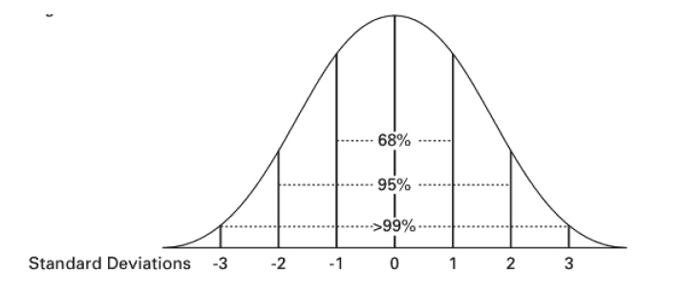
Using Statistical Comparison
Mean ± 2 SD = 95% returned results are acceptable
This gives information on whether your result is acceptable compared with all results and your method
But does it give information on whether your result is acceptable compared to the ‘true’ patient result?
Would your result alter the clinical management of the patient?
Does not provide context to clinical utility

Slide 21
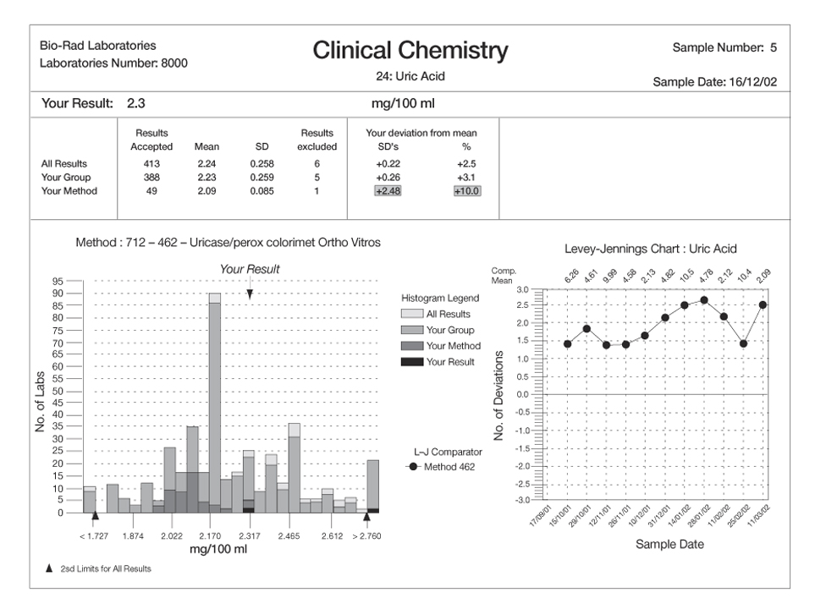

External Quality Assurance Programs
Use quality standards to allow labs to assess their performance and respond accordingly
the quality standard is the allowable difference from a target
A tool for review of QAP results
Can be based on
  statistical comparison
  expert opinion
  clinical need
  other criteria

Slide 22
Target values used in Quantitative EQA
Loss of information for Assessment of accuracy
Reference values
Gold standard
Gravimetric
Overall mean / median
Used if no ref and data Gaussian.
Method mean / median
Peer group assessment only
Analyser mean
Peer group assessment only.

Slide 23
What is the best approach?
Fresh Patient / commutable samples using reference method as target
Fresh patient / commutable samples using a secondary reference method as target
Fresh patient / commutable samples using data from peer group of expert laboratories as target
Mean / median of method group with acceptable performance using fresh patient / commutable samples
Commercial material. - It is essential to understand how the matrix affects the performance of methods if non commutable material is used. Only peer review within instrument / method group can be undertaken in these instances.

Slide 24
Determining Performance specifications.

Slide 25
Acceptable Performance Specification
A range of values around the target value that is considered acceptable laboratory performance
A tool for review of EQA results
It provides a simple tool to allow a rapid, standardised assessment of EQA results in both numerical and graphical report formats.
A result outside the acceptable range should alert the laboratory that that their assay may produce results that are at risk of detrimentally affecting clinical decision making.

Slide 26
Using Statistical Comparison
TEe = 10%
TEa = 5%
Method 1
Method 2
Mean ± 2 SD = 95% returned results are acceptable
This gives information on whether your result is acceptable compared with all results and your method
May not be clinically relevant

Slide 27
Which Performance Criteria to use?
 | Regulatory requirement, TE |  | Acceptable performance from EQA, TE %
Test | CLIA (US) | Rilibak (Germany) | RCPA (Aus) | WEQAS (UK) | Labquality (Finland)
Glucose | ± 0.33 mmol/l or ± 10% | ± 15% | ± 0.5 mmol/l or ± 10% | ± 7.5%@4 mmol/l | ± 6.0%
HbA1c | n/a | ± 18% | ± 0.5 or ± 5% | ± 7%

Slide 28
Specification Hierarchy
Model 1
Model 2
Model 3
Analytical performance specification based on clinical outcomes
Analytical performance specification based on biological variation
“State of the art” - Interlaboratory variation
What we need but data not readily available
Data available but not always achievable
What we can achieve but may not be “fit for purpose”
Data from outcome studies
Improvements in methods / technology

Slide 29
From Biological goals
Test | I (%) | B (%) | TE (%) (0.01)
Glucose | 2.2 | 1.9 | 7.0
HbA1c | 1.7 | 1.5 | 5.5
Desirable quality specification can be calculated from:
I < 0.5CV_{w}
B< 0.25 (CV_{w}² + CV_{b}²)^{½}
TE = 2.33 I + B (a<0.01) for EQA

Slide 30
Analytical goals
 |  | Biological goals |  |  | Weqas TE criteria
Analyte | Conc. | I (%) | B (%) | TE (0.01) | SD | 2 SD | TE
Albumin | 40 | 1.6 | 1.3 | 4.9 | 1.3 | 2.6 | 6.5
Bicarb | 20 | 2.4 | 1.6 | 7.2 | 1.3 | 2.6 | 13.0
Ca | 2.3 | 1 | 0.8 | 3.1 | 0.05 | 0.1 | 4.3
Cl | 100 | 0.6 | 0.5 | 1.9 | 1.4 | 2.8 | 2.8
Creat | 80 | 2.2 | 3.4 | 8.4 | 8 | 16 | 20.0
Glucose | 4.2 | 2.2 | 1.9 | 7.0 | 0.16 | 0.32 | 7.6
Mg | 0.8 | 1.8 | 1.8 | 6.0 | 0.03 | 0.06 | 7.5
Osmo | 245 | 0.7 | 0.4 | 2.0 | 3.4 | 6.8 | 2.8
Phos | 0.8 | 4.3 | 3.2 | 13.1 | 0.03 | 0.06 | 7.5
K | 4 | 2.4 | 1.8 | 7.4 | 0.08 | 0.16 | 4.0
Na | 135 | 0.4 | 0.3 | 1.2 | 1.5 | 3 | 2.2
T P | 70 | 1.4 | 1.2 | 4.4 | 1.6 | 3.2 | 4.6
Urate | 0.34 | 4.3 | 4.8 | 14.8 | 0.02 | 0.04 | 11.8
Urea | 8 | 6.2 | 5.5 | 19.8 | 0.35 | 0.7 | 8.8
Highlighted TE are those where Biological goals not achievable

Slide 32
Choosing an EQA - considerations
Design for clinical need
Material type & frequency
Identify performance specification
Data analysis
Reports
  Education element
  Troubleshooting support

Slide 33
What to Look for in the EQA Reports
Design should be such that the user can:
  Understand the report
  take appropriate action
  provide help and improvement
  Is education

Slide 34
What to Look for in EQA Reports?
What is the turn around time?
  how long after the due date will you receive your report?
  the earlier the better
  can remember what was happening at that time
  can take corrective action sooner
Is the report electronic or paper?
  Electronic quicker but not all sites may have printer access.

Slide 35
What to Look for in EQA Reports?
Report should
  Clearly identify performance
    Assess accuracy to target value
    Assess imprecision
    Assess linearity
    Assess performance over time
    Identify errors and poor performance
  Clearly identify method / analyser performance

Slide 36
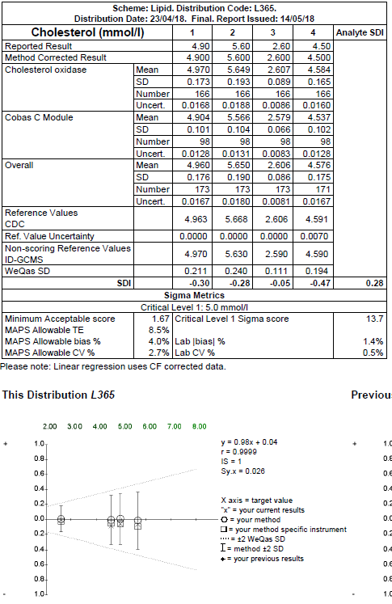
Assessment of Accuracy
From the linear regression analysis equation, y=mx+c, the trueness (bias) is calculated at the critical level (x) , which for Cholesterol is 5.0 mmol/L.
when x=5 then y= 0.9777(*5)+0.042 = 4.9305
Bias = (y-x)/x*100 = (4.9305-5.0)/5.0*100 = -1.39%
Imprecision (CV) = Sy.x/ x = 0.026/5.0*100 = 0.5%

Slide 37
Uncertainty From
EQA Data
Laboratory within run Imprecision:
Sy.x = 0.06 mmol/L
CV% = (Sy.x/ x)*100 = 0.06/7*100 = 0.86%

Slide 38
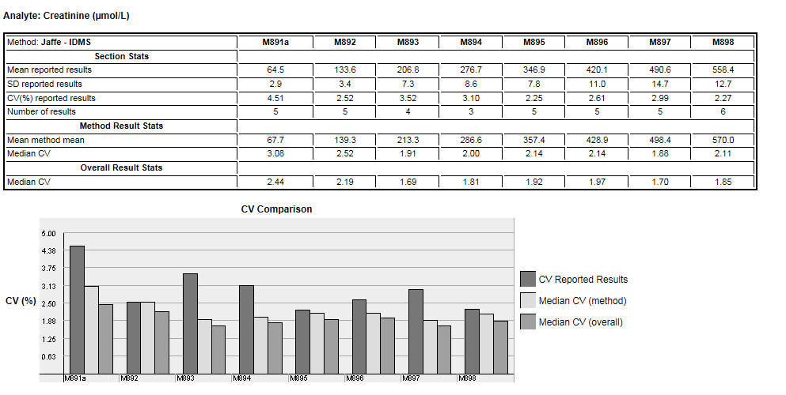
Uncertainty From EQA Data
Between batch CV% provided on End of Batch reports (12 month review)
Pool M891a - CV% of reported results: 4.51%
Top-down approach – CV% is method uncertainty (relative standard uncertainty)

Slide 39
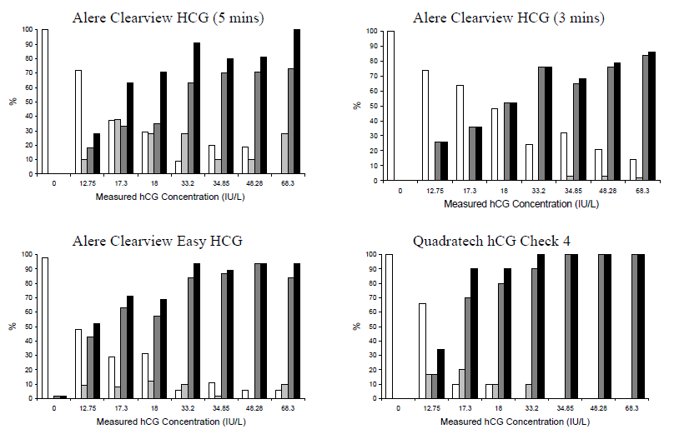
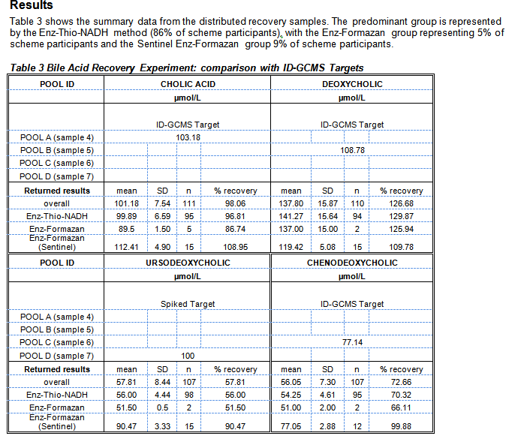
Specificity and Sensitivity Studies
Pregnancy testing
Bile Acids

Slide 40
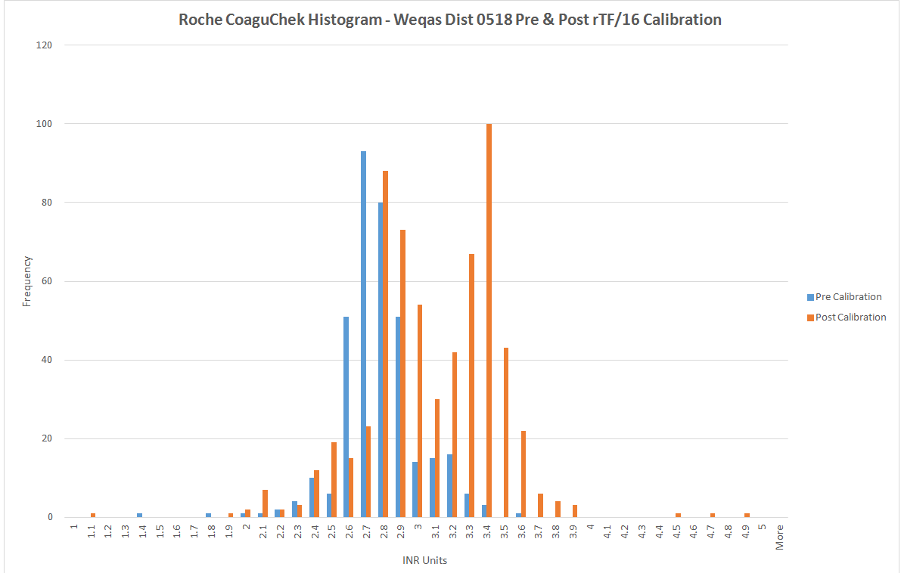
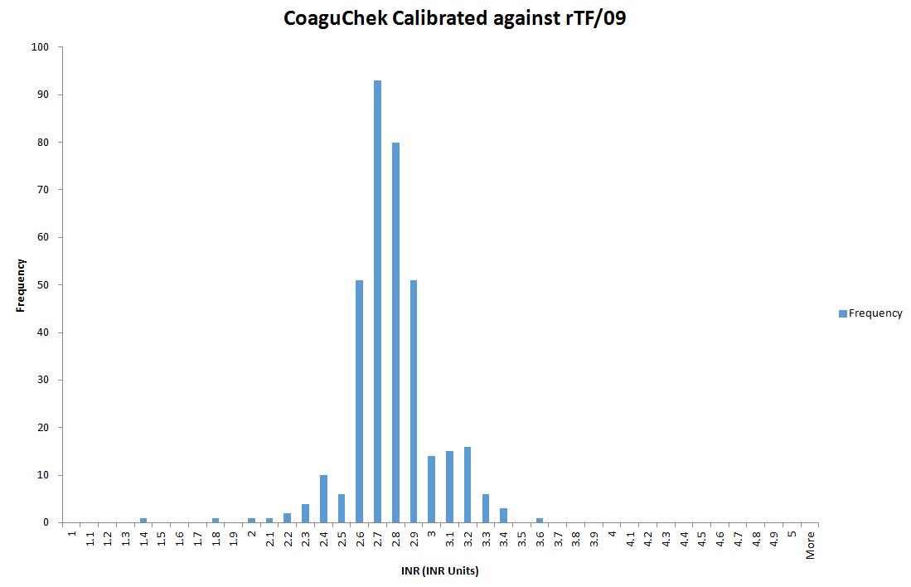
Post Market vigilance – INR thromboplastin
INR results classified into pre and post recalibration.
participants using strips calibrated to WHO reference thromboplastin rTF/09
The pre calibration strips compared well with the results from Distribution 0517 (Median 2.8) however much higher results and a wider distribution of results was observed for the post calibration strips. Weqas immediately contacted the manufacturer and sent them the data.
Aug 2018 – Urgent field safety notice issued to inform users that the manufacturer was reverting back to previous WHO reference standard.

Slide 41
Choosing an EQA - considerations
Design for clinical need
Material type & frequency
Identify performance specification
Data analysis
Reports
Education element
  Troubleshooting support

Slide 42
Educational role
Pre-analytical effects
Number and type of methods used
Performance of methods used
    accuracy
    precision
Susceptibility of methods to interference
    including other analytes and matrix
Interpretation of results

Slide 43
Educational role
Education on methods and interferences
eg
  Concentration near diagnostic “cut off”
  Samples with known variants for HbA1c
  Samples with added interferances

Slide 44
Intralaboratory variation – Roche TnT

Slide 45
Interferences - Effect of icterus on assays

Slide 46
Choosing an EQA - considerations
Design for clinical need
Material type & frequency
Identify performance specification
Data analysis
Reports
Education element
Troubleshooting support

Slide 47
Troubleshooting Support
Can they provide a consultation service?
Available by phone, fax, e-mail
Provide help with
  method classification queries
  analyte problems
  report interpretation
  troubleshooting

Slide 48
Problem Solving Flow Chart
Pages 18-19 of SP-QL1-IntLabEQA

Slide 49
[1] Are you satisfied with
your imprecision values?
(Sy.x, r)
Problem Solving Flow Chart
NO
[3] Check whether the
cause is curvilinear data
(m,c,Sy.x,r)
NO
IMPRECISION
[4] Then the error is random,
check whether there is
clerical error.
YES
NO
Eliminate
blunder
go to [2]
[5]
Check for causes
of imprecision
e.g. inexperienced
operators, faulty
equipment, inappropriate
methods
go to [2]
Pages 18-19 of SP-QL1-IntLabEQA

Slide 50

Problem Solving Flow Chart
Pages 18-19 of SP-QL1-IntLabEQA

Slide 51
Problem Solving Flow Chart
Curvilinear
(m, c, Sy.x, r)
proportional
(m)
mixed
(m, c)
constant
(c)
Check for time
expired reagents
Is it a “one
point” cal?
INACCURACY
NO
NO
YES
YES
Check all
Calibrators
inc. zero
Check zero
(reagent blank,
serum blank,
instrument zero).
Replace
reagents
Recalibrate (try different lot)
Run linearity check
Are you satisfied
with slope (m)?
Are you satisfied
with intercept (c)?
YES
NO
NO
YES
Check slope
value of instrument
Check method
specificity
Adjust & Recalibrate
Pages 18-19 of SP-QL1-IntLabEQA

Slide 52
EQA and User in partnership
Part of Quality Improvement
Should not be viewed as a pass/fail exercise
Educational – troubleshooting, recommendations of best practice
Identify poor methods
Provide training and help

Slide 53
Key elements of National EQA
Competent Authority
Manufacturer
Professional / Regulatory body
EQA Provider
Laboratory
Method performance evaluation
Post market vigilance
Participant Performance evaluation
Quality improvement
Continuous Education
Harmonisation of results
Harmonisation of processes
Audit and recommendations

Slide 55


